Slide 1
Model sensitivity Model uncertainty
Schwartz
reporting on the "debate" over "The Hockey Stick"
Notes:
Older; but, ran came across this when I was in graduate school

Slide 2
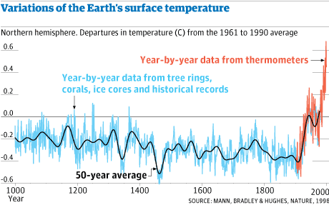
The Hockey Stick scandal!
https://www.theguardian.com/environment/2010/feb/02/hockey-stick-graph-climate-change (2010)
http://www.meteo.psu.edu/holocene/public_html/shared/articles/mbh98.pdf (1998)
https://www.ipcc.ch/site/assets/uploads/2018/03/WGI_TAR_full_report.pdf (2001)
Notes:
The guardian reported:
- there was a "wikileaks" event showing that (behind the scenes) there was very contentious scientific debate about the IPCC (Intergovernmental Panel on Climate Change) report on climate change that was "kept quiet"
- I.e., this showed a serious lack of transparency that cast "doubt" on the climate report
- this is plot shown by the guardian:
- they say this is what is reported by the IPCC
- Although this specific plot is from this 1998 "Nature" article

Slide 3
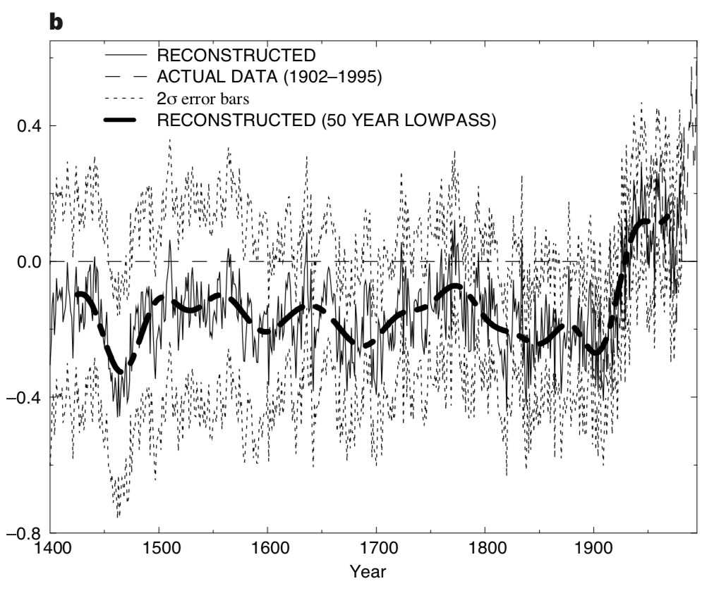
The Hockey Stick scandal!
https://www.theguardian.com/environment/2010/feb/02/hockey-stick-graph-climate-change (2010)
http://www.meteo.psu.edu/holocene/public_html/shared/articles/mbh98.pdf (1998)
https://www.ipcc.ch/site/assets/uploads/2018/03/WGI_TAR_full_report.pdf (2001)
Notes:
Actually, this is the original graph from that research paper...
- in particular note that the axes are different

Slide 4
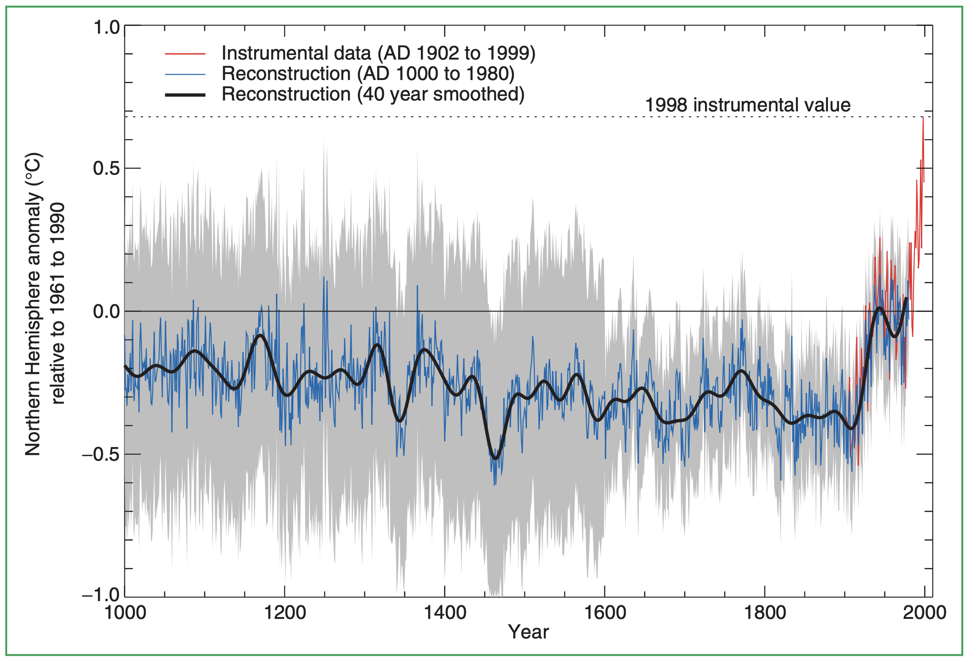
The Hockey Stick scandal!
https://www.theguardian.com/environment/2010/feb/02/hockey-stick-graph-climate-change (2010)
http://www.meteo.psu.edu/holocene/public_html/shared/articles/mbh98.pdf (1998)
https://www.ipcc.ch/site/assets/uploads/2018/03/WGI_TAR_full_report.pdf (2001)
Notes:
And in fact, it's not what is reported in the IPCC report (Intergovernmental Panel on Climate Change)
- black/blue/red ARE correct (and what the guardian reports)
- The "controversy" IS reported – in the usual scientific way... as uncertainty intervals

Slide 5
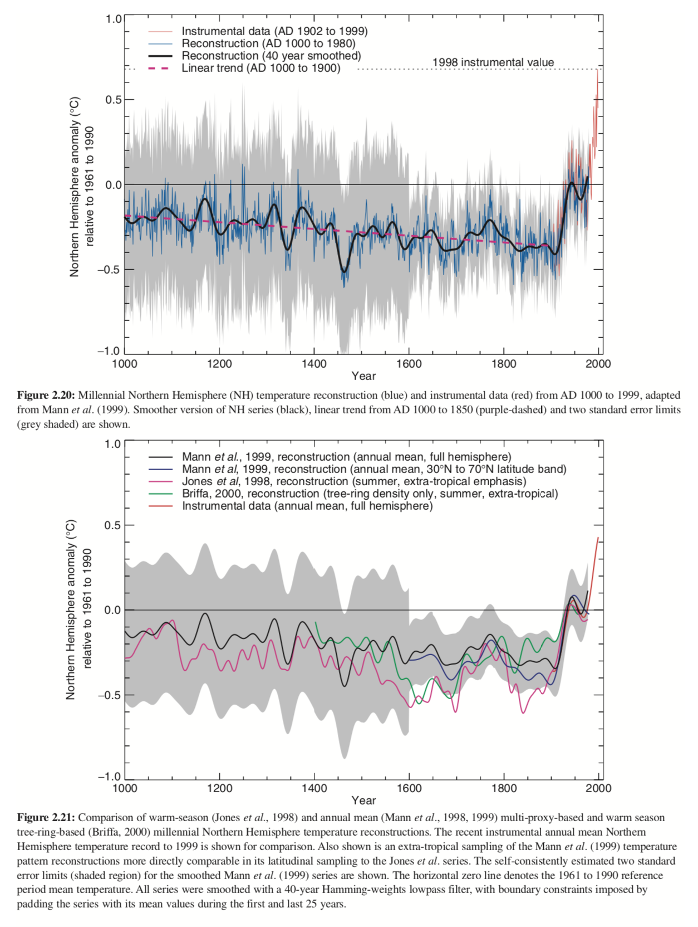
The Hockey Stick scandal!
https://www.theguardian.com/environment/2010/feb/02/hockey-stick-graph-climate-change (2010)
http://www.meteo.psu.edu/holocene/public_html/shared/articles/mbh98.pdf (1998)
https://www.ipcc.ch/site/assets/uploads/2018/03/WGI_TAR_full_report.pdf (2001)
Notes:
And if you dig deeper into the report the alternative reporting which the whole "controversial debate" was about IS reported.
The reported "cover up scandal controversy" is greatly exaggerated...

Slide 6
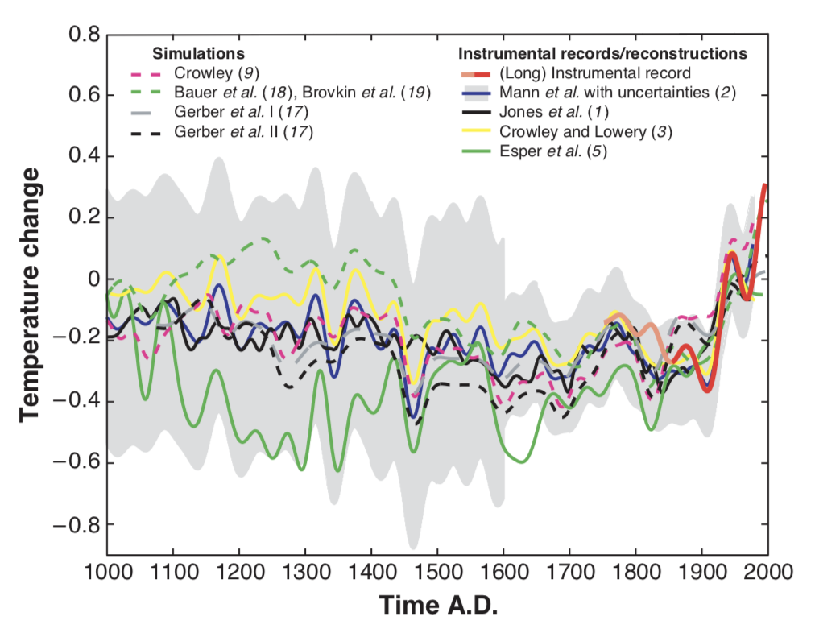
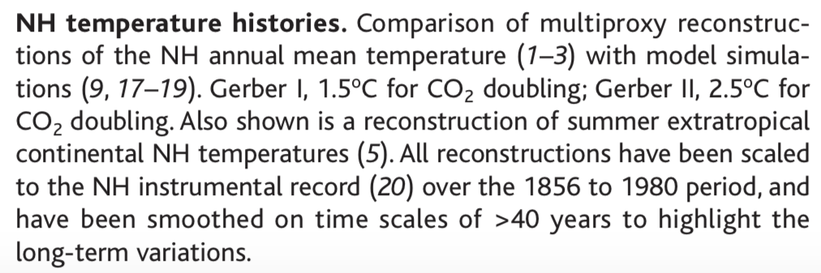
Climate Controversy!
http://www.meteo.psu.edu/holocene/public_html/shared/articles/MannPersp2002.pdf (2002)
https://www.pnas.org/content/105/36/13252/tab-figures-data (2008)
https://blog.ucsusa.org/aaron-huertas/michael-mann-responds-to-misleading-filings-in-climate-change-lawsuit-641 (2012)
https://archive.thinkprogress.org/most-comprehensive-paleoclimate-reconstruction-confirms-hockey-stick-e7ce8c3a2384/ (2013)
https://www.nature.com/articles/ngeo1797 (2013)
https://www.ncdc.noaa.gov/paleo-search/study/14188 (2013)
Notes:
- Here's an example of Mann's work – here reporting uncertainty and different models, analyses, etc.
- This Mann fellow came under a lot of personal attack for his work – a kind of central target for detractors

Slide 7
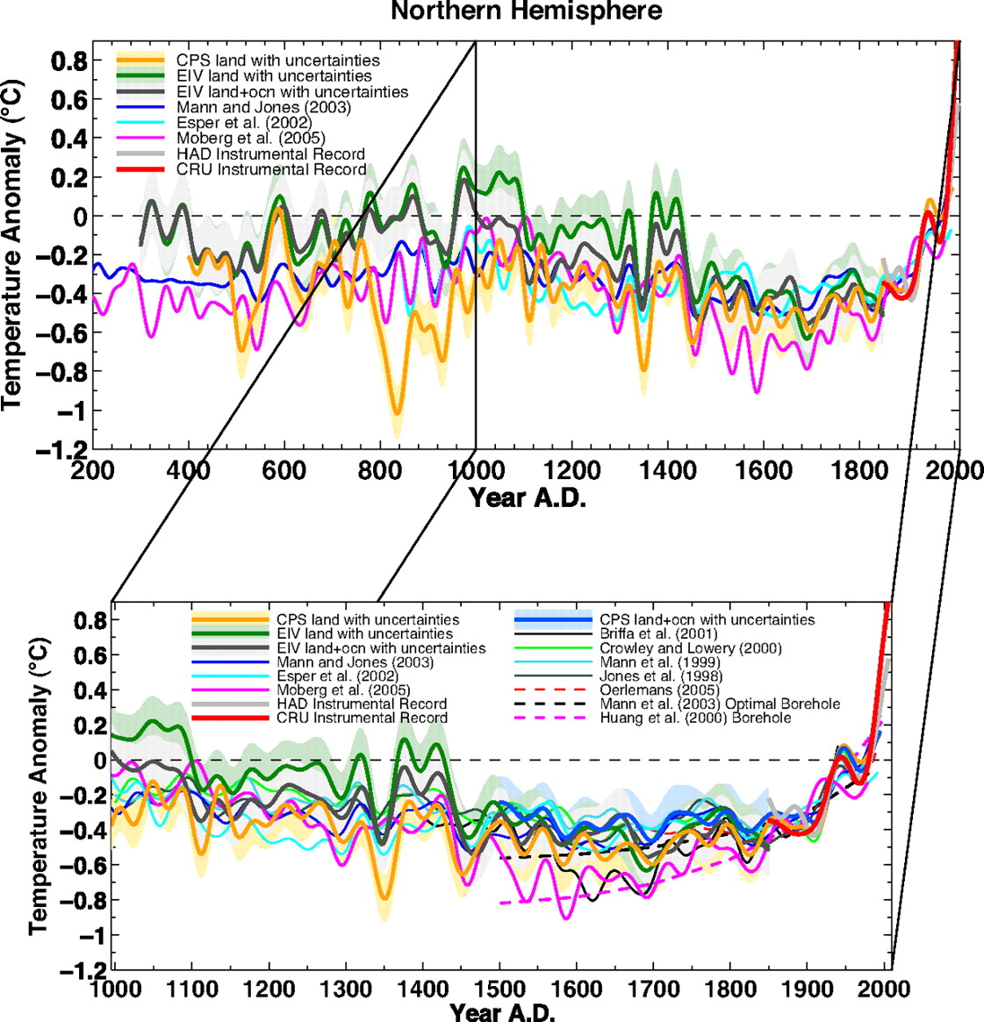
Climate Controversy!
http://www.meteo.psu.edu/holocene/public_html/shared/articles/MannPersp2002.pdf (2002)
https://www.pnas.org/content/105/36/13252/tab-figures-data (2008)
https://blog.ucsusa.org/aaron-huertas/michael-mann-responds-to-misleading-filings-in-climate-change-lawsuit-641 (2012)
https://archive.thinkprogress.org/most-comprehensive-paleoclimate-reconstruction-confirms-hockey-stick-e7ce8c3a2384/ (2013)
https://www.nature.com/articles/ngeo1797 (2013)
https://www.ncdc.noaa.gov/paleo-search/study/14188 (2013)
Notes:
- Here's another example of Mann's work reporting on the accumulating scientific evidence: Different models, analyses, etc.
- So Mann's working on building and understanding "scientific consensus"
- This Mann fellow came under a lot of personal attack for his work – a kind of central target for detractors

Slide 8
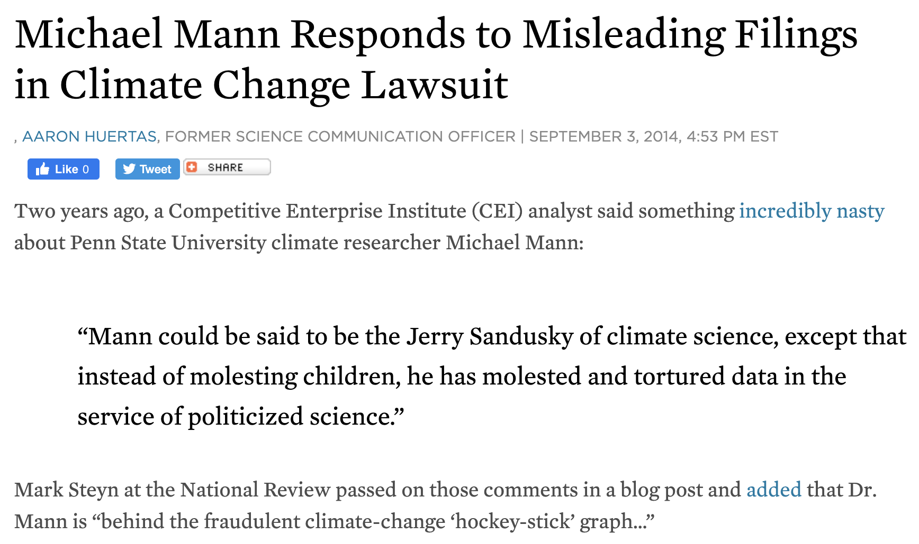
Climate Controversy!
http://www.meteo.psu.edu/holocene/public_html/shared/articles/MannPersp2002.pdf (2002)
https://www.pnas.org/content/105/36/13252/tab-figures-data (2008)
https://blog.ucsusa.org/aaron-huertas/michael-mann-responds-to-misleading-filings-in-climate-change-lawsuit-641 (2012)
https://archive.thinkprogress.org/most-comprehensive-paleoclimate-reconstruction-confirms-hockey-stick-e7ce8c3a2384/ (2013)
https://www.nature.com/articles/ngeo1797 (2013)
https://www.ncdc.noaa.gov/paleo-search/study/14188 (2013)
Notes:
- all of that said, Mann became a representative "figure head" of climate science
- This Mann fellow came under a lot of personal attack for his work – a kind of central target for detractors
- Sandusky sex offender convicted in 2011... also at PSU... strange coincidence? Certainly leveraged... here conflated...

Slide 9
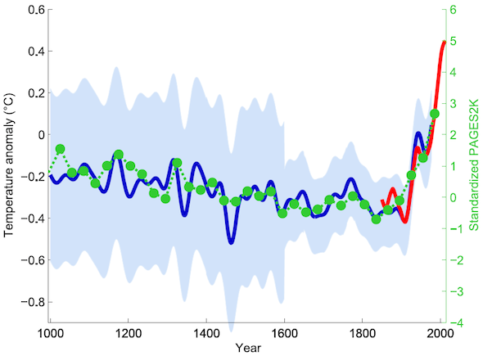
Climate Controversy!
http://www.meteo.psu.edu/holocene/public_html/shared/articles/MannPersp2002.pdf (2002)
https://www.pnas.org/content/105/36/13252/tab-figures-data (2008)
https://blog.ucsusa.org/aaron-huertas/michael-mann-responds-to-misleading-filings-in-climate-change-lawsuit-641 (2012)
https://archive.thinkprogress.org/most-comprehensive-paleoclimate-reconstruction-confirms-hockey-stick-e7ce8c3a2384/ (2013)
https://www.nature.com/articles/ngeo1797 (2013)
https://www.ncdc.noaa.gov/paleo-search/study/14188 (2013)
Notes:
Then there was pushback defending Mann: the green data is from this 2013 study/efforts

Slide 10
Statisticians...
https://projecteuclid.org/download/pdfview_1/euclid.aoas/1300715170 (2010)
"Next Article -->" 13 times
For 13 "Discussion of" 's
Including Mann et al.
"Next Article -->" 1 more time for a "rejoinder"
https://projecteuclid.org/download/pdfview_1/euclid.aoas/1300715184
https://archive.thinkprogress.org/most-comprehensive-paleoclimate-reconstruction-confirms-hockey-stick-e7ce8c3a2384/ (2013)
Notes:
A little before all of this worst parts of the drama, some statisticians got involved.
They didn't look at this (because it hadn't happened yet)

Slide 11
Statisticians...
https://projecteuclid.org/download/pdfview_1/euclid.aoas/1300715170 (2010)
"Next Article -->" 13 times
For 13 "Discussion of" 's
Including Mann et al.
"Next Article -->" 1 more time for a "rejoinder"
https://projecteuclid.org/download/pdfview_1/euclid.aoas/1300715184
http://www.meteo.psu.edu/holocene/public_html/shared/articles/MannPersp2002.pdf (2002)
Notes:
Which is actually based on this 2002

Slide 12
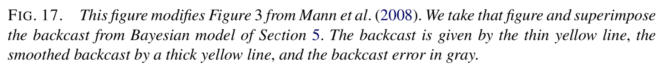
Statisticians...
https://projecteuclid.org/download/pdfview_1/euclid.aoas/1300715170 (2010)
"Next Article -->" 13 times
For 13 "Discussion of" 's
Including Mann et al.
"Next Article -->" 1 more time for a "rejoinder"
https://projecteuclid.org/download/pdfview_1/euclid.aoas/1300715184
https://www.pnas.org/content/105/36/13252/tab-figures-data (2008)
Notes:
Instead, the stats folks used this 2008 Mann data/paper

Slide 13
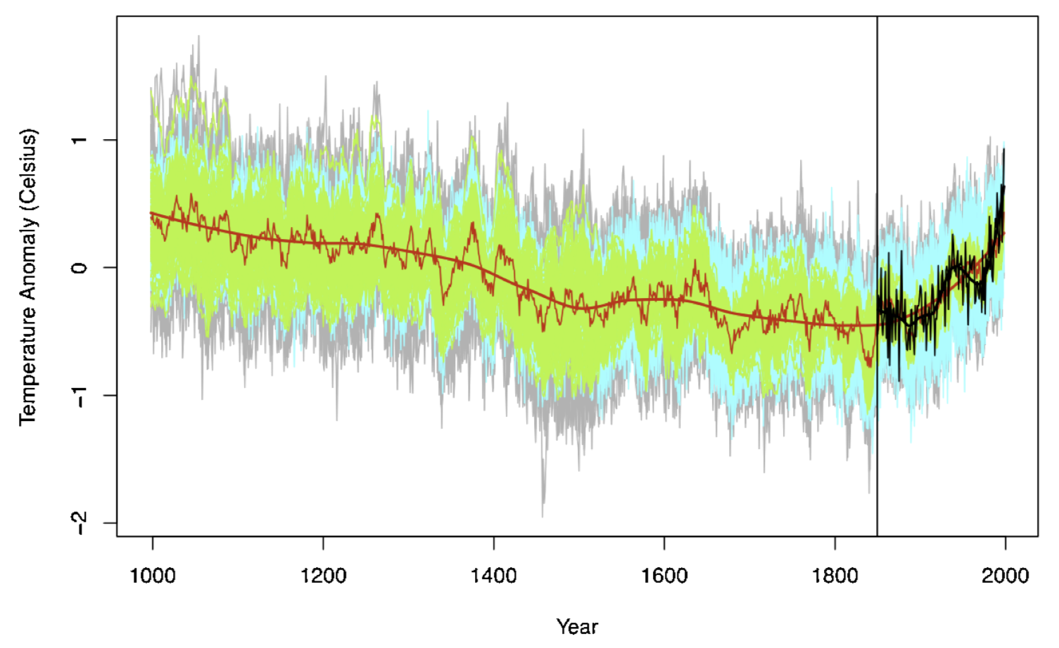
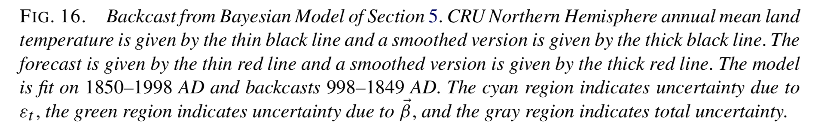
Statisticians...
https://projecteuclid.org/download/pdfview_1/euclid.aoas/1300715170 (2010)
"Next Article -->" 13 times
For 13 "Discussion of" 's
Including Mann et al.
"Next Article -->" 1 more time for a "rejoinder"
https://projecteuclid.org/download/pdfview_1/euclid.aoas/1300715184
)
https://www.pnas.org/content/105/36/13252/tab-figures-data (2008)
Notes:
They used the Mann 2008 data and came up with this
- You will recreate this in your homework

Slide 14
Statisticians...
https://projecteuclid.org/download/pdfview_1/euclid.aoas/1300715170 (2010)
"Next Article -->" 13 times
For 13 "Discussion of" 's
Including Mann et al.
"Next Article -->" 1 more time for a "rejoinder"
https://projecteuclid.org/download/pdfview_1/euclid.aoas/1300715184
https://www.pnas.org/content/105/36/13252/tab-figures-data (2008)
Notes:
Then they noted how different it was from what Mann reported

Slide 15
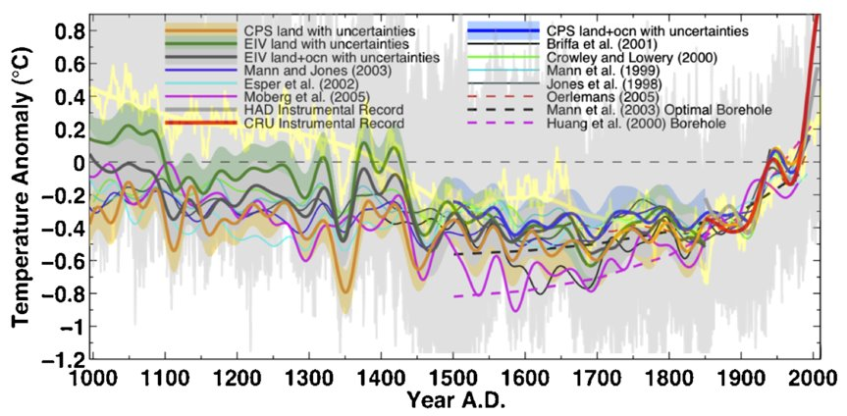
Statisticians...
https://projecteuclid.org/download/pdfview_1/euclid.aoas/1300715170 (2010)
"Next Article -->" 13 times
For 13 "Discussion of" 's
Including Mann et al.
"Next Article -->" 1 more time for a "rejoinder"
https://projecteuclid.org/download/pdfview_1/euclid.aoas/1300715184
https://www.pnas.org/content/105/36/13252/tab-figures-data (2008)
Notes:
Then there was a huge discussion about it
My review of it is that the statisticians are right.
Like it's laughable hearing applied applications researchers arguing with the discipline researchers who made the methodology they're using

Slide 16
Statisticians...
https://projecteuclid.org/download/pdfview_1/euclid.aoas/1300715170 (2010)
"Next Article -->" 13 times
For 13 "Discussion of" 's
Including Mann et al.
"Next Article -->" 1 more time for a "rejoinder"
https://projecteuclid.org/download/pdfview_1/euclid.aoas/1300715184
https://www.pnas.org/content/105/36/13252/tab-figures-data (2008)
Notes:
I'll do this the opposite way
- You will recreate this in your homework

Slide 17
Statisticians...
https://projecteuclid.org/download/pdfview_1/euclid.aoas/1300715170 (2010)
"Next Article -->" 13 times
For 13 "Discussion of" 's
Including Mann et al.
"Next Article -->" 1 more time for a "rejoinder"
https://projecteuclid.org/download/pdfview_1/euclid.aoas/1300715184
(2008)(2008)(2008)(2008)(2008)(2008)(2008)(2008)
http://www.meteo.psu.edu/holocene/public_html/shared/articles/MannPersp2002.pdf (2002)
Notes:
I'll do this the opposite way
- You will recreate this in your homework

Slide 18
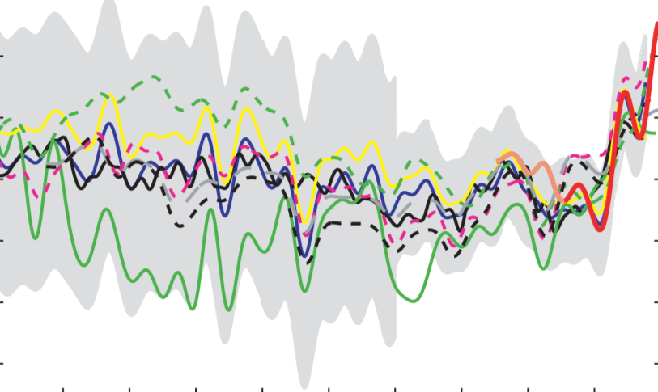
Statisticians...
https://projecteuclid.org/download/pdfview_1/euclid.aoas/1300715170 (2010)
"Next Article -->" 13 times
For 13 "Discussion of" 's
Including Mann et al.
"Next Article -->" 1 more time for a "rejoinder"
https://projecteuclid.org/download/pdfview_1/euclid.aoas/1300715184
https://www.pnas.org/content/105/36/13252/tab-figures-data (2008)
http://www.meteo.psu.edu/holocene/public_html/shared/articles/MannPersp2002.pdf (2002)
Notes:
I'll do this the opposite way
- You will recreate this in your homework

Slide 19
Statisticians...
https://projecteuclid.org/download/pdfview_1/euclid.aoas/1300715170 (2010)
"Next Article -->" 13 times
For 13 "Discussion of" 's
Including Mann et al.
"Next Article -->" 1 more time for a "rejoinder"
https://projecteuclid.org/download/pdfview_1/euclid.aoas/1300715184
https://www.pnas.org/content/105/36/13252/tab-figures-data (2008)
Notes:
I'll do this the opposite way
- You will recreate this in your homework

Slide 20
Don't do this: confirmation bias
https://archive.thinkprogress.org/most-comprehensive-paleoclimate-reconstruction-confirms-hockey-stick-e7ce8c3a2384/ (2013) [defense]
https://blog.ucsusa.org/aaron-huertas/michael-mann-responds-to-misleading-filings-in-climate-change-lawsuit-641 (2012) [attack]
http://www.meteo.psu.edu/holocene/public_html/shared/articles/MannPersp2002.pdf (2002) [blues]
https://www.nature.com/articles/ngeo1797 (2013) [greens]
https://www.ncdc.noaa.gov/paleo-search/study/14188 (2013) [greens]
Notes:
Confirmation Bias?
Now why didn't they show the uncertainty in their plot?
You will *IMPROVE THIS* in your homework

Slide 21

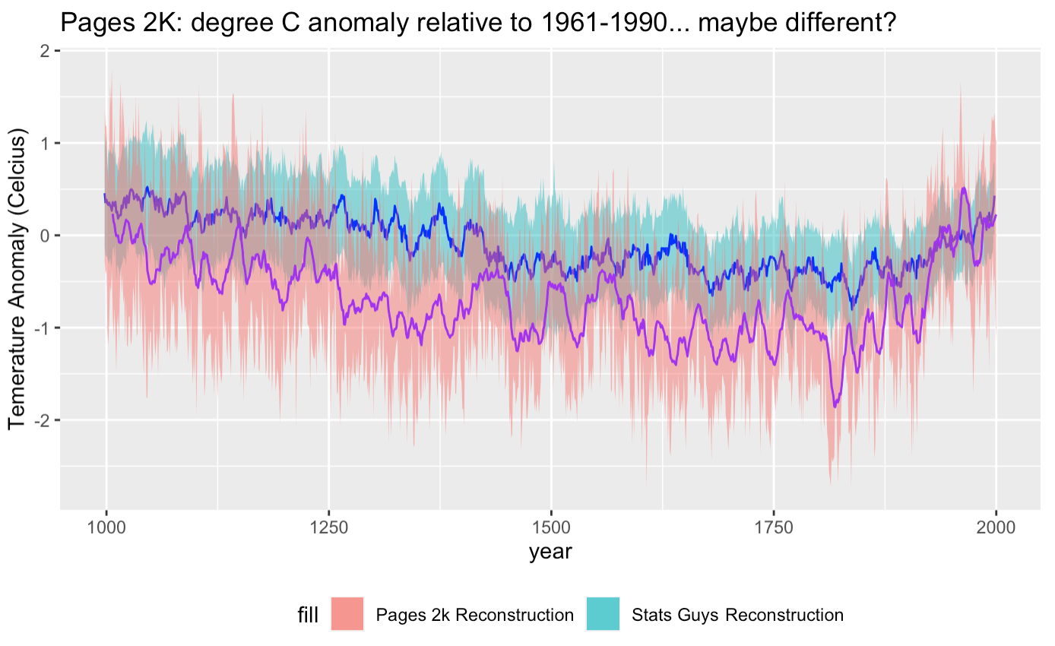

Do DO this: check out the data for yourself AKA: Your ASSIGNMENT
Plot "Stats Guys" reconstruction with uncertainty
https://projecteuclid.org/euclid.aoas/1300715170#supplemental
load("/path/to/what/you/downloaded/above/and/in/it/bayes_recon.R")
Plot the "Pages 2k" reconstruction with uncertainty
http://pastglobalchanges.org/science/wg/2k-network/data
https://www.ncdc.noaa.gov/paleo-search/study/16973
Reconstruction v1.1.1
Some code to get you started is available on the course website
Notes:
Confirmation Bias?
Now why didn't they show the uncertainty in their plot?
You will *IMPROVE THIS* in your homework

